Slide 1
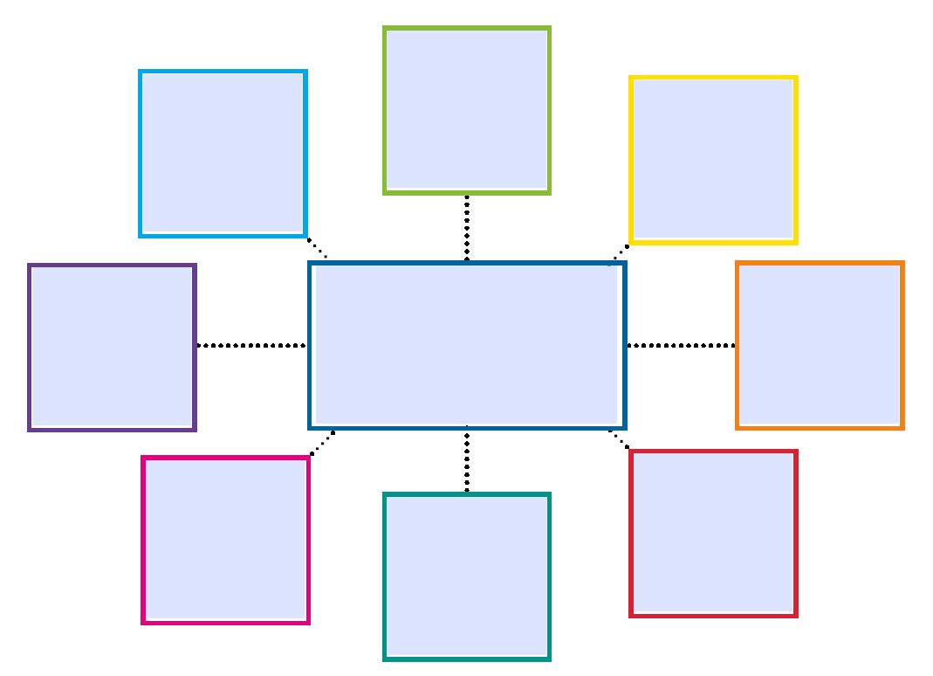

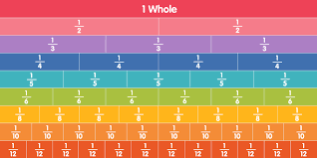

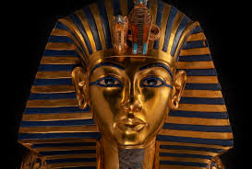

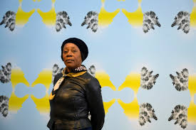
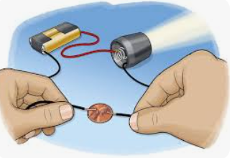
It would be wonderful if you could encourage your child to log in to the following interactive resources to support their learning:
Times Tables Rockstars, and/or Timestables.co.uk.
Reading with your child and discussing their books at least 3 times a week really does support their comprehension skills, build on their imagination and support their writing. Please log each time you read so your child can earn rewards ☺
Also, any practising of all the spellings they have had over the last couple of terms would be great and very helpful!
This term’s additional events include:
Kurling taster day
World Book day
The Big Plastic count
Science Week
Year 4 class trip to Kent Life
Parents’ Evening
Easter church service
Maths
We will be continuing to learn about measurement including length and perimeter as well as begin to dig deeper into fractions.
History Our topic will be continuing to learn all about the Ancient Egyptians.
English
We will be looking at the story called ‘The Lost Happy Endings’ and writing a twisted narrative and persuasive letter.
Art
For Art we will be learning about Sonia Boyce and exploring her methods and artistic style. Then we will try to create our own inspired pieces.
Hawthorn Class
PSHE
Our area this term will be looking at ‘Don’t hold on to what’s wrong!’
Newsletter Term 3
R.E and worldviews
In RE and worldviews we will be discussing who was Jesus really?
Science
Next term we will be learning all about sound and how it travels whilst exploring pitch and volume.
Computing
Next term we will be introduced to data and information and learning all about data logging.

